Slide 1
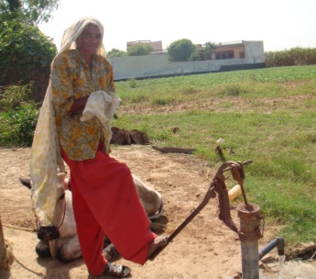
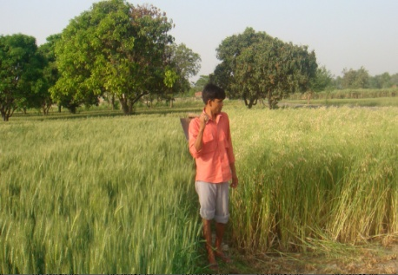
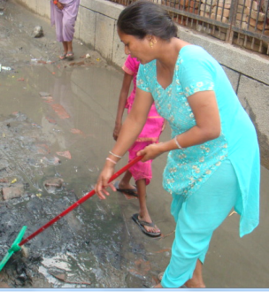
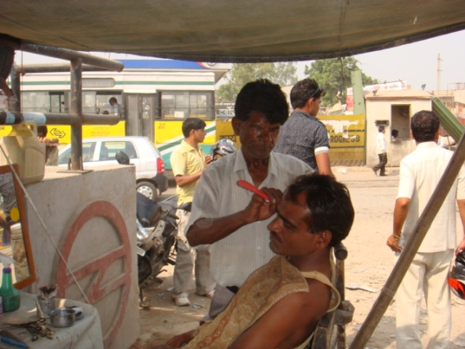
Lower End Livelihoods in a Semi-Liberalised Economy
Glimpses from a Village and a Slum in the National Capital Region
Paper by
Dr. Devesh Vijay
Associate Professor, Zakir Husain Delhi College at
Sociology Research Colloqium
Department of Sociology, University of Delhi.
September 19, 2014

Slide 2
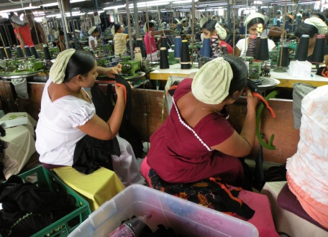
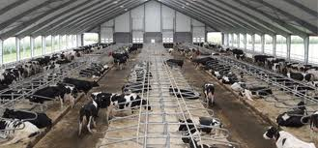
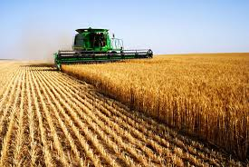
Changing Nature of Work and Occupations
Over the past two centuries, ‘work’ underwent a major transformation all over the developed world aided by mechanization, modern management and the digital revolution.
At the macro level also, decline in shares of agriculture and rural population; rise of the formal economy with higher productivity, mechanization etc; increased labor mobility increased while women’s count in economic work rose across west as well as large chunks of East Asia and Latin America more recently.

Slide 3
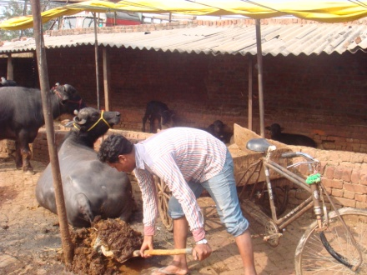
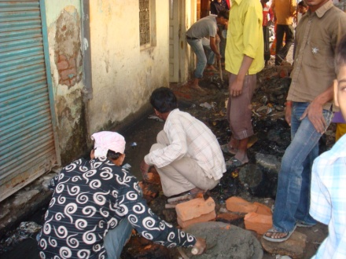
The Indian Experience
Among colonies, India had early beginnings of modern industry and transport as also historic efforts for Swadeshi and planned development; Lately, we have witnessed some decline in share of agriculture, rise of IT and construction etc.
Yet, only 7% of secure formal employment, only 11% of workers in manufacturing and high levels of underemployment, a ‘shadow economy’ and segmentation based on caste and gender persist.
Some improvements in occupational profile since the introduction of partial economic liberalisation (without labor and bureaucratic reforms).
For example, agriculturists down to 49%; construction and financial services up by 6 and 5 per cent respectively.

Slide 4
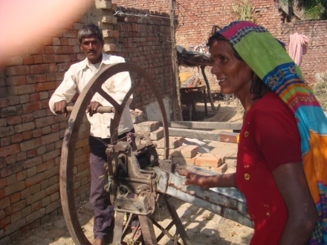
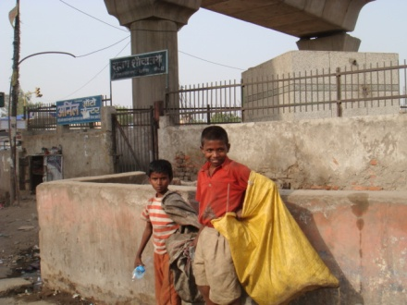
Statistical Puzzles
Need to delineate obstacles in occupational diversification and worker productivity.
India has a highly professional and experienced survey organizations (quite unique in the developing world).
Yet, critical differences persist between figures provided by the Census Commission and the NSSO on subsidiary work, women’s participation etc.
More intriguingly, puzzling temporal twists noted lately, with unemploy- ment growing along with increased employment generation and vice versa; and swings in data in women’s work participation etc.
Also, lack of clarity on extent of the black economy, multiple occupations, subsidiary work etc.
Categorisation of Workers also based on western models largely.

Slide 5
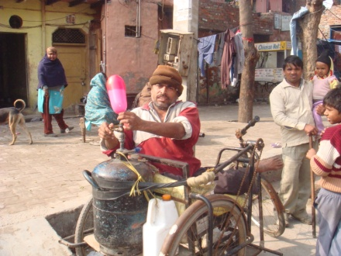
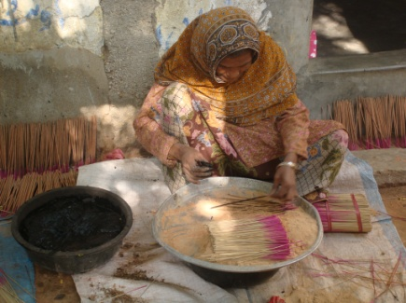
Focus of this Paper
Need to enrich our understanding of aggregate data sets with some long term micro studies of diverse communities is evident.
The present attempt is a long term study of a village and a slum in NCR with three revisits since 1988 focusing on shifts in livelihoods since 1930s. Choice of a village and a slum for a glimpse of Bharat.
Terms like livelihoods, occupations, work and employment have distinct connotations (earning strategies, personal specialization, assigned work position etc.) but used interchangeably too.
Clear and agreed distinction between economic ‘work’ and non-work however; same followed here but with detailed categorization to the latter.
Comparisons attempted: not between the selected sites (evidently from diverse rural and urban settings) but over time (within each site) and between trends discerned in my research zone and those identified at the macro level by national surveys, as also other studies of villages and slums in India.

Slide 6
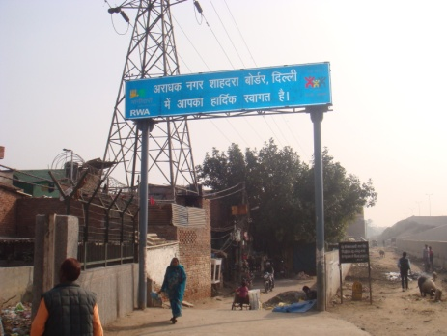
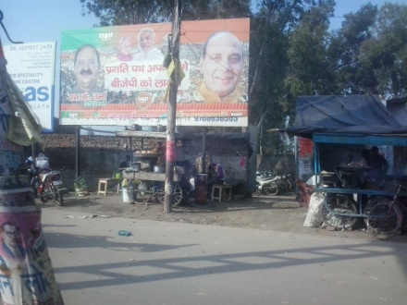
The Sites
Before proceeding with the description of employment trends noted in Dhantala and Aradhaknagar, over past eight decades, it is imperative to provide an overview of the said locations here. Dhantala is a middle sized village of almost 2800 residents in Meerut district of UP
Aradhaknagar is a fast changing slum of almost 1800 dwellers on the Delhi-UP border, along the G.T Road. My first engagement with both these communities began in 1988 when I surveyed them while finalizing my M. Phil dissertation on ‘Neighborhood Research’ at the University of Delhi.

Slide 7
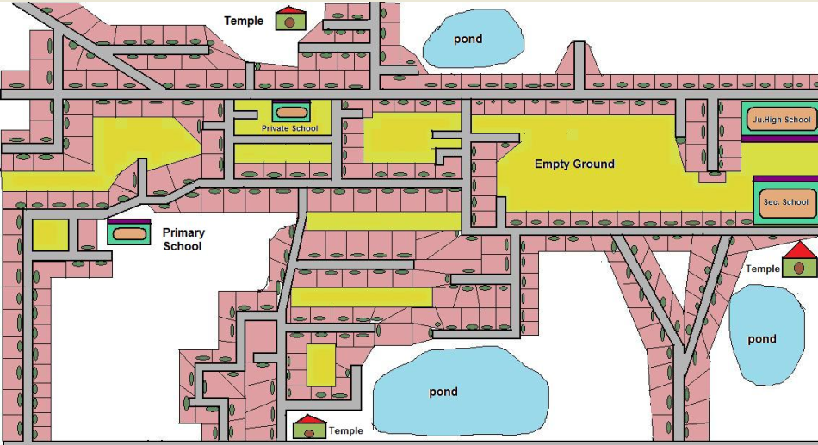
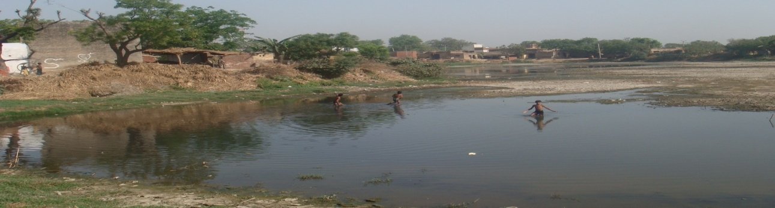
Layout of Dhantala 2009

Slide 8
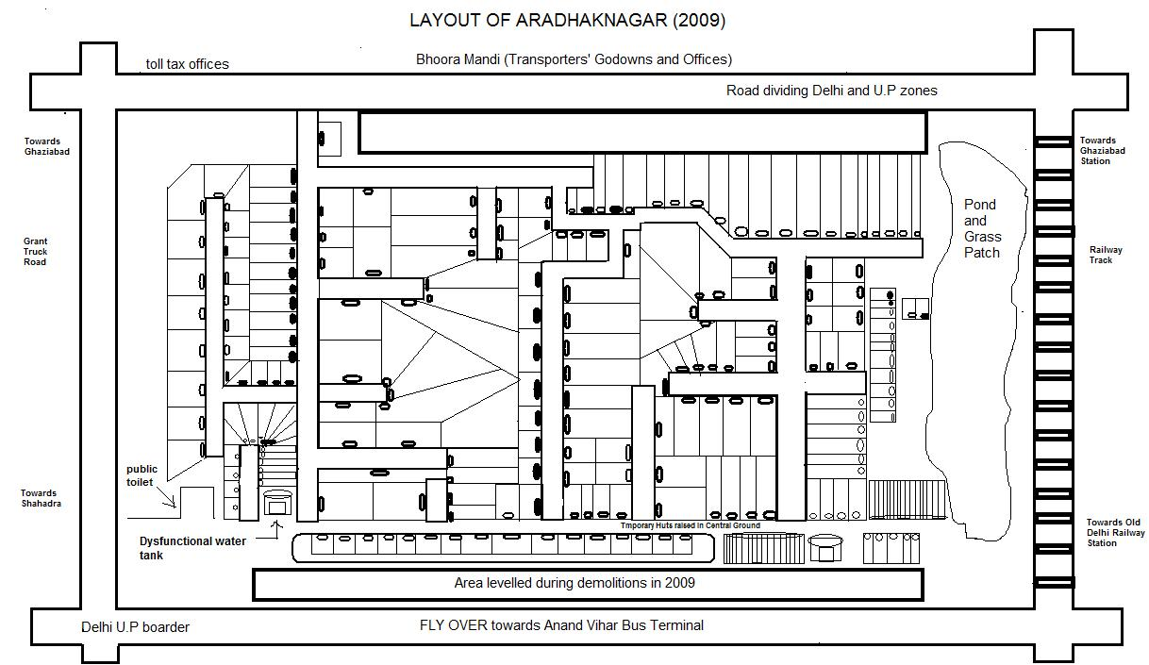
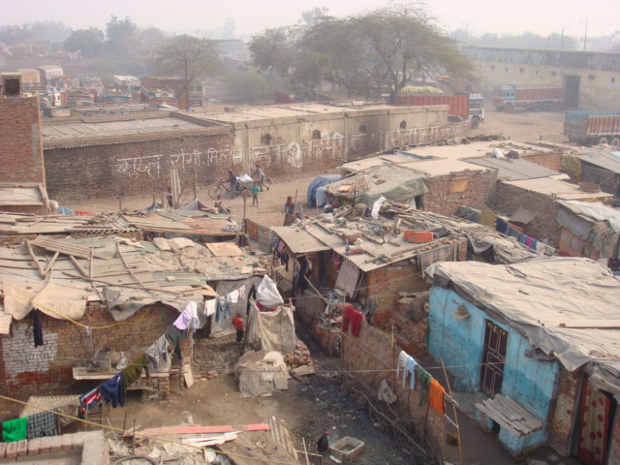

Slide 9
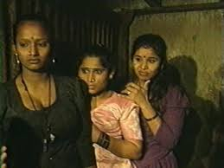
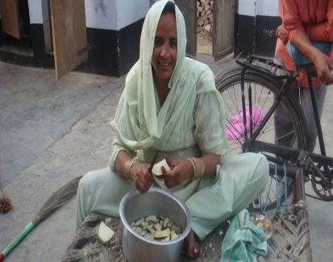
Pitfalls in Occupation Counts and Tabulation
Defining, classifying and counting of work, however, is more complex than appears. We have referred to distinctions between terms like…
Grey areas also in counting illegal and quasi legal occupations; workers engaged in home based food processing, dairy etc which account for substantial uncounted work in underdeveloped economies; etc. Marshall’s quip re marrying his cook--.
Besides complexities in defining and counting work, problems in applying west centric international classifications of occupations (like the ten fold NOC) in India where subjects’ concern with job continuity and social security is much greater than in the west. Thus the standard practice of cross classifying ten major work categories with a 3 X 3 classification of principal/ subsidiary/ non-work; self employment/ salaried/ casual labor and primary/ secondary/ tertiary occupations.
Self employment includes highly specialized physicians as well as home based vendors. Thus, it is materially insignificant for a worker whether s/he is in petty self employment or casual labor or even in skilled or unskilled work than her location in formal and specially government employment.
Native work categories such as majoori, kaam, naukri, dhanda, kaarobar, babu and ‘afsar’ are concerned .less with industrial classification and activity status and more on continuity, safety and social security apart from status and access to networks.

Slide 10
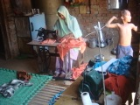
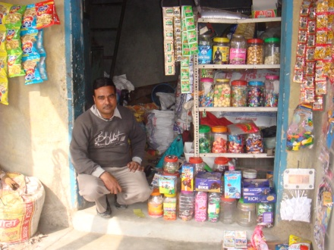
National Classification of Occupations in India
follows closely National Occupations Classification of the Developed World with with inadequate Attention to the Primary and the Informal Sector
A. Management
B. Professional
C.Technical and paraprofessional
D. Administration and administrative support
E. Sales
F. Personal and customer Information services
G.Industrial,construction equipment operation trades
H.Workersand labourers in transport and construction
I. Natural resources, Agriculture and related occupations
J. Occupations in manufacturing utilities

Slide 11
Principal Occupations amongst the Major Castes of Gangaikondam, Tamil Nadu, 2008
Category/ Caste |  | Thevar Total |  | Konar |  | Pallar (Hindu) |  | Pallar |  |  | All Village
1. | Professional | 6(1) |  | 7 | (2.1) | 23 | (2.5) | 21 |  | (4.3) | 83 (2.9)
2. | Administrative | 1 (0.2) |  | 6 | (1.8) | 9 (1.0) |  | 1 |  | (0.2) | 0.8)
3. | Clerical | 14 | (2.3) | 7 | (2.1) | 17 | (1.8) | 9 |  | (1.8) | 2.4)
4. | Sales Workers | 39 | (6.3) | 9 | (2.6) | 19 | (2.0) | 9 |  | (1.8) | .0)
5. | Service Workers | 27 | (4.3) | 17 (5.0) |  | 19 | (2.0) | 6 |  | (1.2) | .0)
6. | Cultivators | 90 (14.5) |  | 54 | (15.9) | 266 | (28.4) | 171 |  | (35.0) | 616 (21.2)
6a. Agricultural Laborer |  | 50 | (8.1) | 41 | (12.1) | 100 | (10.7) | 21 |  | (4.3) | 245 (8.4)
6b. Agricultural related |  | 62 (10.0) |  | 18 (5.3) |  | 7 (0.7) |  | 2 |  | (0.4) | 3.3)
7 | Production (a) | 105 | (16.9) | 40 (11.8) |  | 110 | (11.8) | 53 |  | (10.9) | 5.0)
8. Production (b) |  | 8 (1.3) |  | 8 | (2.4) | 12 | (1.3) | 11 (2.3) |  |  | 154 (5.3)
9a. Drivers |  | 22 | (3.5) | 9 | (2.6) | 29 | (3.1) | 25 |  | (5.1) | 97 (3.3)
9 | Construction | 26 | (4.2) | 16 (4.7) |  | 60 | (6.4) | 34 |  | (7.0) | 167 (5.7)
9c. General Labor |  | 141 | (22.7) | 92 | (27.1) | 181 | (19.4) | 78 |  | (16.0) | 579 (19.9)
Total Labor force |  | 621 |  |  | 340 | 935 |  |  | 488 |  | 2906
Work articipation |  | 38.4 |  | 43.1 |  | 46.3 |  | 46.3 |  |  | 42.2
Source: Household census data, 2008 cited in Harris, John, et.al, Rural Urbanism in Tamil Nadu: Notes on a “Slater Village”: Gangaikondam, 1961-2012, Review of Agrarian Studies.

Slide 12
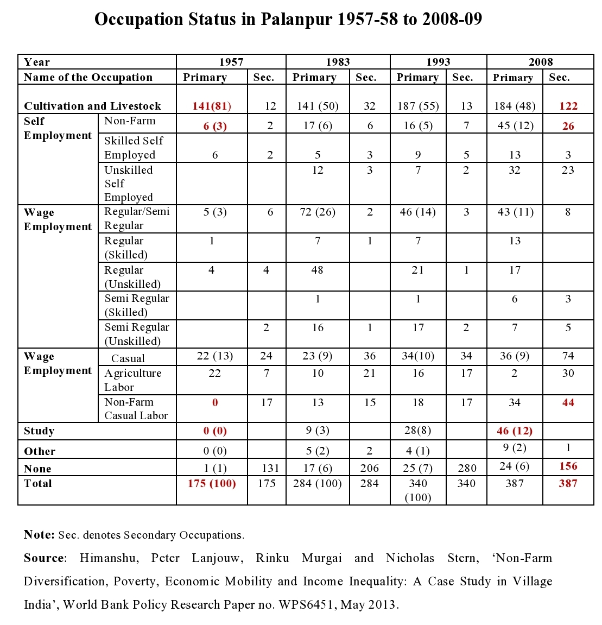
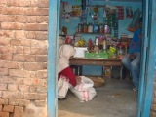
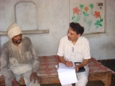

Slide 13
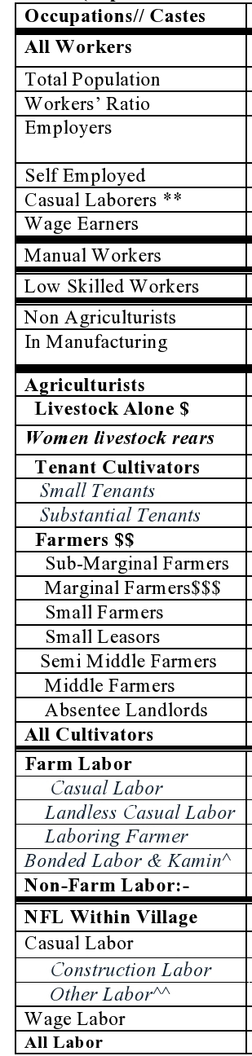
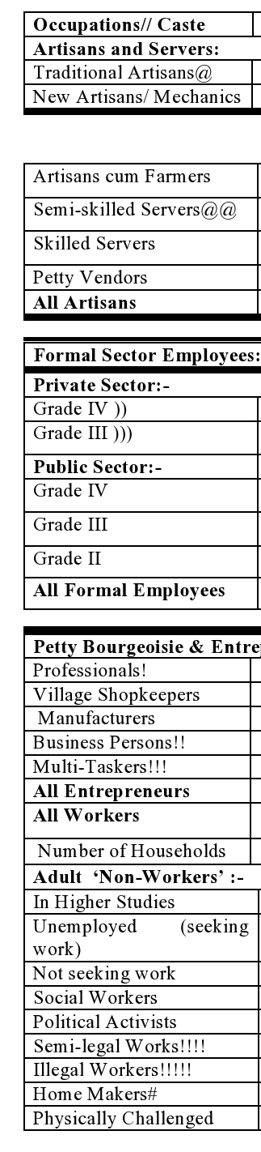
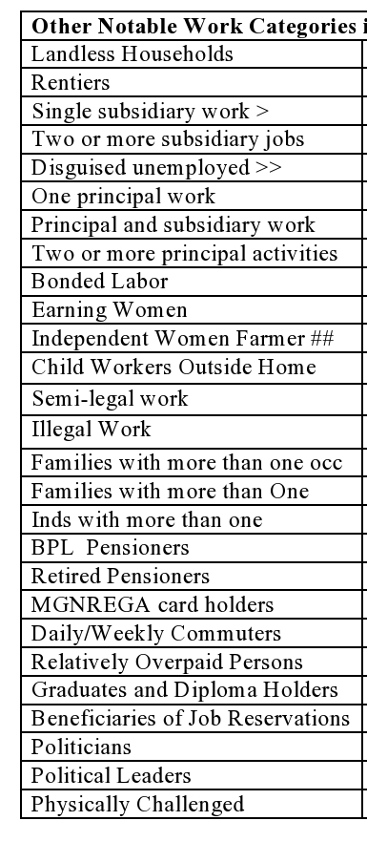

Slide 14
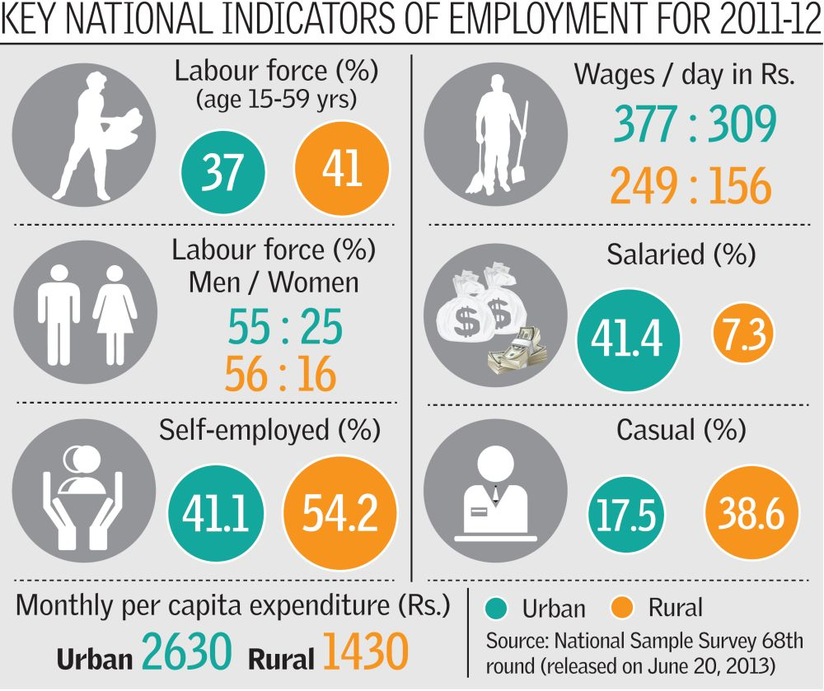
Glance at Existing Research
Long term studies and restudies of villages have a rich tradition nurtured by sociologists and economists like Guhan, John Harris, Susan Wadely, Peter Lanjouw, S.S. Jodhka and Jean Dreze in India. However, longitudinal studies of Indian slums have been rare and comparative long terms studies of village and slums appear extremely scarce. On the other hand, macroeconomic perspectives on employment in India are well served with panel data since independence.

Slide 15
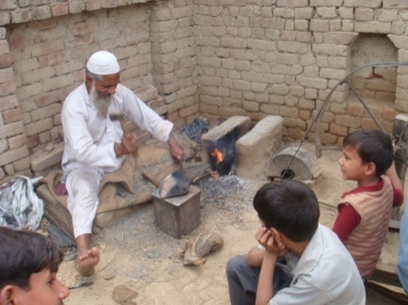
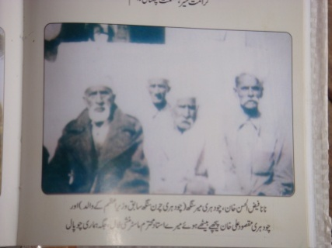
Five Policy Regimes over Selected Time Span:-
Using oral history methods and some documentary evidence, information could be gathered in the studied communities from about 1930s. The span since then has been divided into five phases as follows:-
The Late Colonial Era (1930-47) saw a turnaround in population growth from 1920s; but negligible reduction in poverty; average per capita income grew by less than 1% annually; BPL population estimated at over 66% retrospectively.
The Planning Era (1951-67): Five Year Plans, Green and White Revolutions make some dent in poverty which came down to about 55% by 1991 (as per Tendulkar Committee criteria).
The Indira Years (1967-84): Nationalisation, Green Revolution, centralization, corruption and populism.
Liberalisation Decades (1985-2006): Sharpening Inequalities but reduction in poverty from 55% of population to 37%; simultaneous upturns in literacy, IMR, birth control, construction etc.
Inclusive Growth (2006-13): Poverty continues to decline and government data now show 27% BPL population; but inflation hits the poor hard and seems to have negated the gains from higher public spending on food security, Mgnregs etc

Slide 16
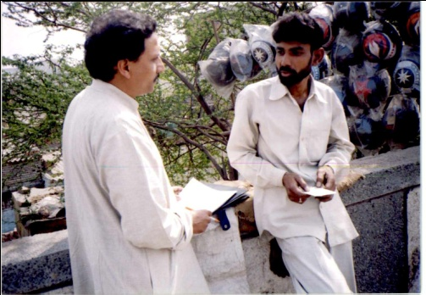
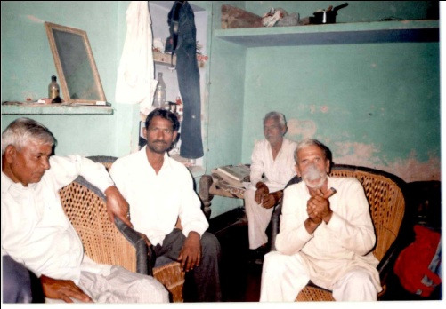
Methodology:-
To trace long term shifts in the employment pattern of the selected communities, a multi-method approach (involving oral history, surveys, interviews and life sketches as well as documentary and photographic evidence) found relevant.
Four levels of comparisons: temporal, sectoral, national and global.
The presence of a few able bodied nonagenarians in Dhantala and some septagenarians in Aradhaknagar, facilitated my effort to gather evidence on the pre-independence local economy also. So did group discussion and participant observation besides personal interviews.
House to house survey on a number of economic indices was completed, in Dhanatala and Aradhaknagar, by an assistant. I myself used repeated visits for focus group discussions with various segments of the population. The technique appeared useful with remarkable candidness and mutual knowledge among studied subjects.
An unconventional tool for continued engagement found in the cellphone now available with subjects for filling gaps between visits.

Slide 17
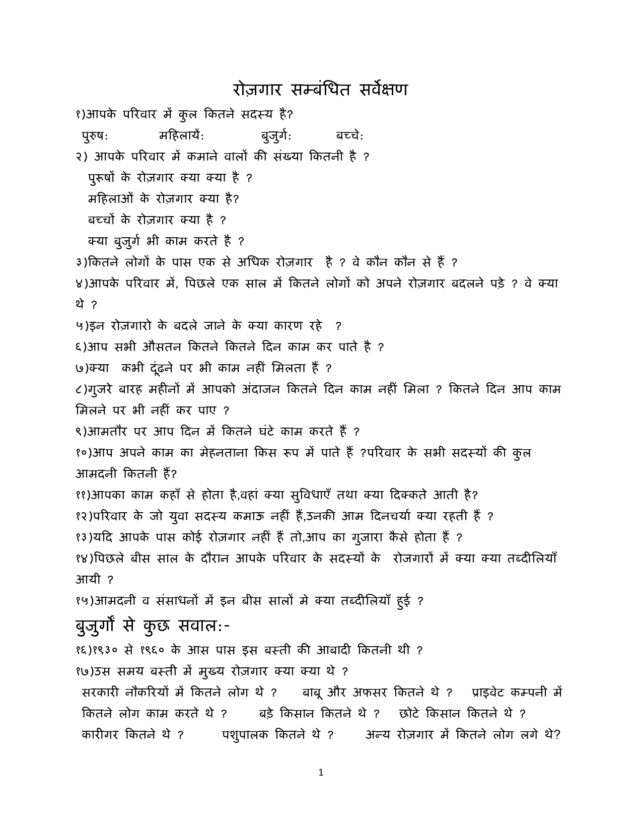
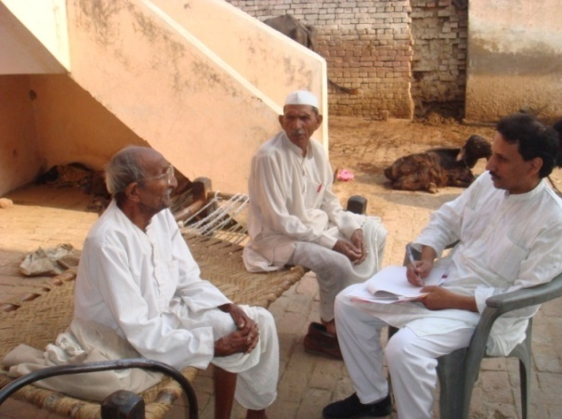
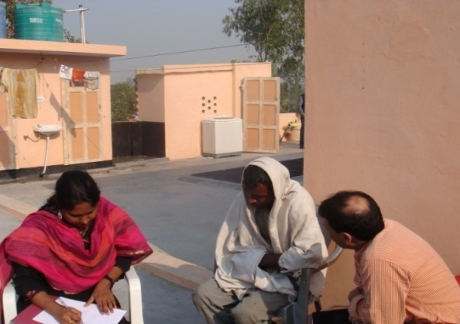

Slide 18
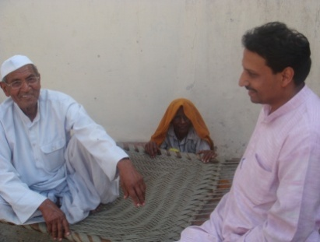
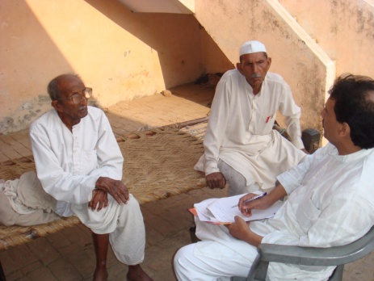
Limitations of the Study
Even well funded surveys aided by several assistants and long duration participant observation face problems in precision data; even same respondent may offer different responses to a query.
This present study, based on the recall of elders and on focus group discussions does not claim high precision in gathered statistical evidence. However, thru repeated visits and chats at the sites, over past 25 years, it is hoped that broad contours of shifts in livelihoods have been captured.
The study is not presented as a sampler for wider trends in employment; chosen after several trials through personal references rather than ‘random or stratified sampling’ for throwing up issues for future enquiry rather than major generalisations.

Slide 19
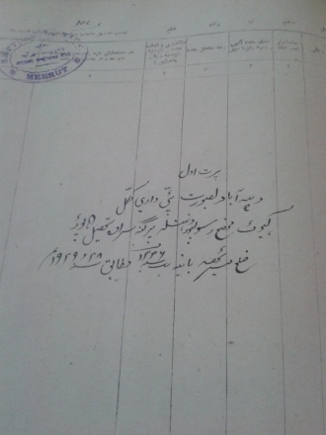
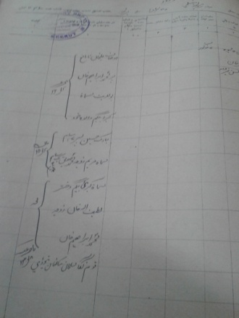
Precautions Taken
To restrict own bias and control over evidence, have taken a few precautions. Firstly, the work is open to further scrutiny and revisits by other scholars as actual names have been used both of the studied sites and of subjects who could be with consent safely.
In order, to get the subjects’ opinions and voice into writing, I also maintained field notes in Hindi and sought subjects’ views on them. An advance draft of this paper was distributed in Hindi in both locations.
My Bias
However cautious or conscencious a researcher may be, unlikely to preempt assumptions from weighing upon data selection and interpretation. Best option constant reflexivity and transparency.
My ideological position ‘left-liberal’ implying valuing equality and liberty together. More specifically, I view not abolition of property but checks on inheritance as more pertinent for social justice, along with progressive taxation for financing comprehensive social security.
Intellectual influences on me: Max Weber, Karl Popper, Anthony Giddens.

Slide 20


The Macro Picture
Broad transitions in livelihoods include: disappearance of jajmani/ laagbandi arrangements in the countryside along with a decline of hereditary work within sub-castes; declines also in agriculture, self employment, big landlordism and in traditional crafts; notable rise in construction, services, rural non farm sector, student population and migrant labor; but stagnation in manufacturing and formal employment.
Growing commercialization, mechanization and specialization in occupations and some rise in productivity is a secular trend but extremely anemic (as compared to the west as well as the tigers and lesser cats of east Asia and Latin America).
More intriguing developments have been: decline in work force despite rise in the working age population; rise in real wages despite steep inflation and mechanization of work.

Slide 21
Table I: India’s Occupational Profile: circa, 1951-2011
Sector/ Year | 2011-12 |  | 1951 etc.
 | Employment Data | Other Details | Employment Data | Other Details
Total Population | 1200 million appr. | GDP 90 lakh crore appr. (20 times since 1951) | 370 million in 1951 | GDP: Rs. 10,000 crore in 1951 prices (4.5 lakh crore in 2011 prices)
Working Age Population | 63% |  | 60% in 1911; 53% in 1981
Labor Force | 45% of Total and 75% of Work Age |  | 43% of Total Population in 1991
Work force | 39 % of Total Population | 33% of urban population 16% of urban women | 41% of Population in 2004. 37% in 1991
Unemployed | 6.6% of labor force | About 1.1 crores new job seekers bt 2004-09 but 1.8 crores found employment | 8.2% of labor force in 2004; 6% in 1991
Growth of Employment | 0.5 % p.a.2004-09 |  | 2.5 % p.a. 1999-04 (including 7.5% in manufacturing)
Main Workers | 78 % |  | 72% in 2004
Marginal Workers | 22 % of workers and 9% of population |  | 8% in 1971
Women ‘Workers’ | 25% of Adult Women | (31% in rural and 15% in urban) | 31% in 2004 27% in 1991 | (withdrawal of 25 million rural women between 2004-2011)
Child Workers | 2.5% of Workers |  | 5% in 1991
Self Employed | 52% of workers (42% own account and 10% family workers) | Urban 42% | 59 % 1977; 55% in 1991 | Urban 41%
Salaried Workers | 18% of workers | Urban 43% | 14% in 1977 | Urban 41
Casual Workers | 30% of workers | Urban 15% | 27 % 1977; 23% in 1973 | Urban 16
Employers | 1% of all workers |  | 0.5%
Worker Productivity in Services | 8.7 times of agricultural work |  | 3 times of agricultural work
Black Economy Estimate |  | 50% or more of GDP |  | NA
Domestic Work (Not counted in WPR) |  | 15% of GDP appr (?) |  | Much Higher

Slide 22
Informal Sector | 86% (exclud. 7% contractual in Formal Sector) | 60% of GDP (12% each of informal manu, trade services constn and 12% agri) |  | 93% in 1951 | Formal Sector in China: 32% in 2001; Thailand:42%; U.S.: 89%; Japan: 91%
Formal Sector Workers | 2.9 crore |  |  | 2.7 crore in 1991
Unorganized Workers in Formal Sector | 50 % |  |  | 33% in 1993
Formal private Sector Workers | 1.1 crore in 2010 |  |  | 0.7 crore in 1981
Public Sector Workers | 1.8 crore employees appr. (62% of formal employees) | 20 % of GDP (?) |  | 1.5 crore in 1981 1.9 crore (72% of formal workers in 1991) | NA
Salary Bill of Public Sector Employees | 12 lakh crore (15% of GDP) |  |  | 11 % of GDP in 1991
Agriculturists (99% are S.E./ unorganized) | 49 % of all workers | 14 % of GDP |  | 75 % in 1951 66% in 1991 | 66 % 1911; 57% in 1951; 30% in 1991
Share of Agriculturists among informal workers | 60% |  |  | 70% in 1991
Dependent on Animal Husbandry Alone | 2 % | NA |  | 4% (?) | NA
Industry (Including Construction) | 19% | 27% of GDP |  | 12% thru1951 to 1991 | 20% in 1951, 25% in 1971, 28% in 1991
Construction alone | 8 % |  |  | 2.5 % in 1991
Services | 28% (upto 75 % in advanced countires) | 59% of GDP |  | 13% in 1951, 13% in 1971, 25% in 1991 | 12% in 1951, 17% in 1971, 42% in 1991
Rural Non Farm Sector | 39% of rural workers | More than 50 % of rural output |  | 15 % in 1971, 17% in 1991, 22% 2001 | 34% 1994, 40% in 2001
RNFS Employment Breakup in 2005 | Rural Manufacturing 8%, construction 5% Trade 6% Transport 2.5% Services 6%
Cultivated Area | 163 million hectares |  |  | 159 million hectares in 1991
No. of agricultural holdings | 137 million in 2011 |  |  | 90 millions in 1981

Slide 23
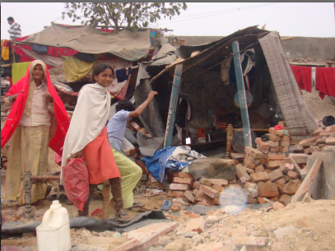
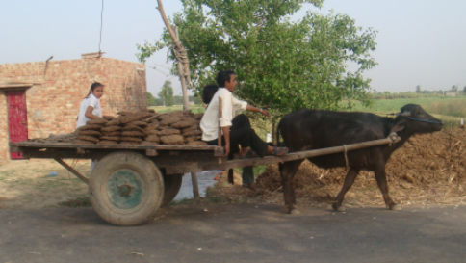
Segments within Farmers:-
Independent Farmers (Who do not hire out labor) | 55% of Agriculturists |  | 65%
Marginal and Small Farmers | 86 % of Farmers | 40 % of Cultivated Land | 66% in 1991 | 20% in 1991
Medium Farmers | 10% |  | 27%
Tenants | 9 % |  | 11% in 1990
Big holdings (above 10 acres) | 4% of Farmers (own 30 % of land) | 1 million big holdings (0.8% of total holdings and 10% of cultivated area) | 2.2 million big holdings in 1981. | Covering 90 million acres
Rural Labor (Farm and Non Farm) | 45% in 2011 (?) |  | 33% in 1991
Agricultural labor | 25% of agriculturists in 2004 (20% landless and 80% marginal farmers) | 98% of agricultural labor are casual and 2 % are regular wage ern | 30% of agriculturists in 1993
Landless Agricultural Labor | 6 % of Agriculturalists and 20% of Agricultural Labor |  | ?
Migrants Workers (in past one year) | 40 million |  | 30 million in 2008
Note: All data in this table is in rounded figures only.
Sources: National Sample Survey Organisation Reports including Employment and Unemployment Survey 68th Round, 2011-12; Registrar General of India and Census Data as cited in Datt and Sundharam, Indian Economy, 2013.

Slide 24
Economic Indicators: Some International Comparisons: 2009
Country /Indicator | Gross National Income per capita (in $) | Population Below Poverty Line (1)* | Formal Sector Share in Employment | Minimum Wages in $ per hour | Labor productivity in agriture (Per annum per wrkr in $) (2) * | Employ-ment in Agriculture (% of Employed) | Unemployment (% of labor Force) | Urban Population (%) | Life Expectancy at Birth Female / Male | Forested area (% of Land Area) | Energy Consumption per Capita per annum (3)* | Per capita CO2 Emission Estimates (4)*
India | 1073.1 | 68.7 % | 16.4 % | 0.61 | $ 500 | 50 | 8 to 6% | 30.0 | 66.9 / 63.7 | 22.9 | 396.0 | 1.4
Sri Lanka | 2082.9 | 29.8 % ? 5 | 38 % | 0.94 |  | 31.3 | 5.2 | 14.3 | 78.6 / 71.3 | 30.0 | 200.0 | 0.6
Malaysia | 6732.1 | 9% | 65% | 1.79 |  | 14.8 | 3.3 | 72.2 | 77.6 / 72.9 | 62.8 | 2714.0 | 7.0
Thailand | 3719.4 | 15 % | 58 % | 2.04 |  | 41.7* | 1.2 | 34.0 | 72.8 / 67.1 | 37.1 | 1211.0 | 4.3
Indonesia | 2080.3 |  | 27.5 % | 0.86 or 2.32 |  | 41.2 | 8.4 | 44.3 | 74.3 / 70.2 | 52.9 | 565.0 | 1.8
Vietnam | 1032.0 |  |  | 0.56 |  | ….. | 2.4 | 30.0 | 77.4 / 73.3 | 43.6 | 425.0 | 1.3
Cuba | 5355.4 |  |  | 0.08 ? |  | 18.7 | 1.6 | .. | 81.3 / 77.2 | 26.3 | 878.0 | 2.4
Brazil | 7948.6 |  |  | 2.04 |  | 19.3 | 8.2 | 1.1 | 77.2 / 69.9 | 61.9 | 882.0 | 1.9
US, Japan etc |  |  | Up to 90% | 8$ | $ 50,000 $ 48,000 in Japan | 2 to 5%
Source: World Statistics, United Nations 2010.
*Notes: ( 1) US $2 per day per capita; (2) Worker productivity in India has risen in services from three times of agriculture in 1951, to 8 times agriculture; (3) Kilograms Oil Equivalent; (4) Metric Tons

Slide 25
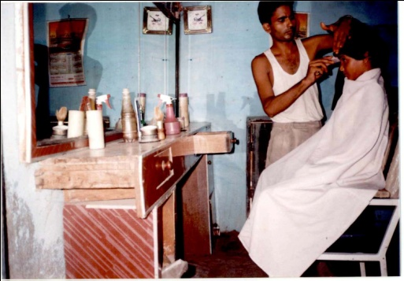
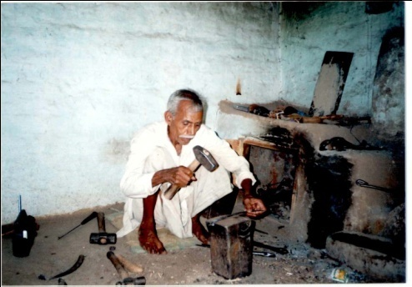
Occupational Shifts in Dhantala and Aradhaknagar
At the micro level, occupations that have disappeared over past eight decades in Dh and Ar include: big landlords, bonded labor, animal skinning and traditional water carriers; categories that have dwindled include big farmers, male cattle rearers, and crafts like pottery; new categories gaining prominence are professionals like teachers and health workers, gadget repairs and room renting. Swelling livelihoods are those of domestic maids in the slum and marginal farmers and commuting laborers in Dh.
Despite these changes, quality of work has changed little for the majority in both locations as workers remain tied to hard manual labor (90%), low wage and low skill informal work (70 to 80%) and have little social security.
However, self employed workers are down and formal work for sweepers (largely Valmikis) has grown in Ar.

Slide 26
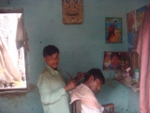
Table 2: Estimated Occupations in Dhantala: 1989-2012
(Usual Principal + Subsidiary Status Workers; Figures in brackets denote women workers)*
Occupations// Years | 1989 | 2012 | SCs in 2012
All Workers | 883 (336) | 1099 (399) | 271 (70)
Total Population | 2080 | 2604 | 599
Workers’ Ratio | 42% | 42% | 45%
Employers** | 31 4% | 38 3% | 03 01%
Self Employed | 708 81% | 710 65% | 137 51%
Casual Laborers | 88 10% | 228 21% | 86 31%
Regular Wage Earners | 41 5% | 107 10% | 45 17%
Paid Women Workers (inc | farm labor) 45 | 56 | 30
Manual Workers | 837 95% | 983 89% | 260 95%
Low skilled Workers | 745 85% | 874 79% | 256 94%
Non Agriculturists*** | 175 20% | 381 35% | 114 42%
In manufacturing | NA | 62 inc 25 artisans and 02 employers
Agriculturists:- | 698 80% | 718 65% | 157 58%
Rear Livestock Alone $ | 05 | 02 | 02
Women Livestock Rearers | 281 | 341 | 76
Tenant Cultivators
Small Tenants | 16 | 07 | 03
Substantial Tenants | 00 | 01 | 00
Farmers:- $$ | 346 | 341 | 76
Sub Marginal Farmers | 15 | 69 (1) | 22
Marginal Farmers $$$ | 140 | 148 | 34
Small Farmers | 140 | 78 | 20
Small Leasors | 10 | 08 | 0
Semi Middle Farmers | 31 | 13 | 0
Middle Farmers | 17 | 02 | 0
Absentee Landlords | 00 | 00 | 0
Capitalist Farmers | 00 | 01 | 00
All Cultivators | 362 (3) 40% | 328 (1) 29% | 79 (1) 29%

Slide 27
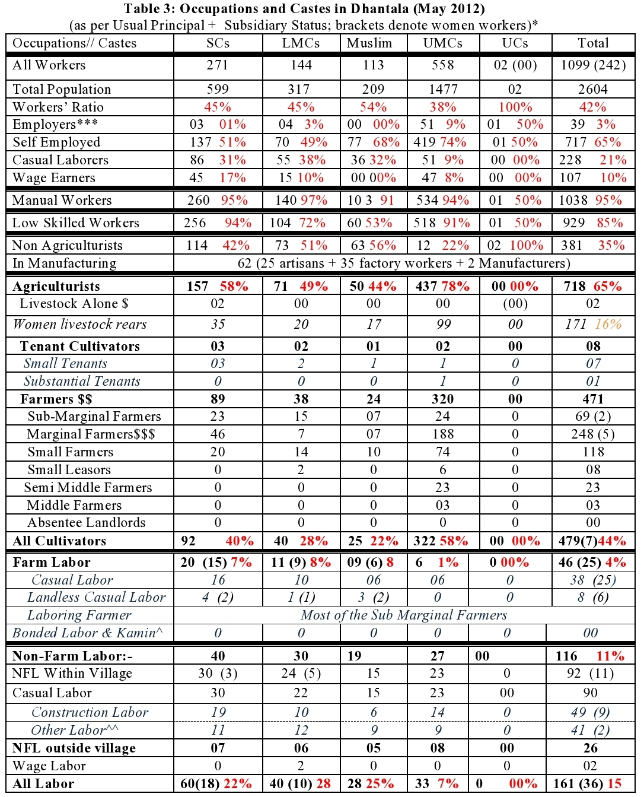
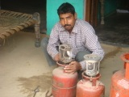
Occupations and Castes in Dhantala (May 2012)
(As per Usual Principal/ Subsidiary Status)*­
Table III: Occupations and Castes in Dhantala (May 2012)
(as per Usual Principal + Subsidiary Status; brackets denote women workers)*­
Contd..

Slide 28
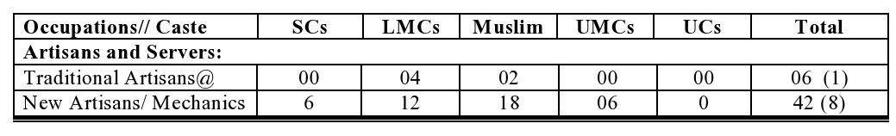
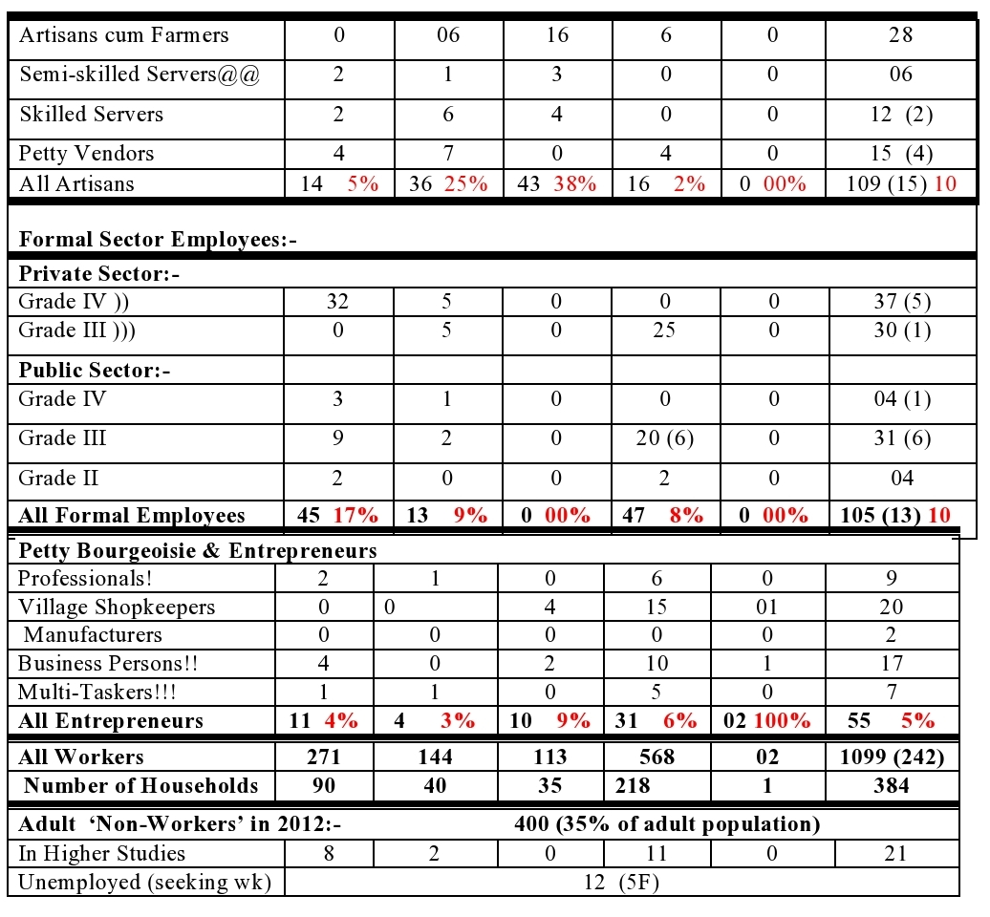




Slide 29




Slide 30



Estimated Occupations in Dhantala: 1930-2012 (Principal+Subsidiary
Status; figures in brackets denote no. of women workers)

Slide 31




Slide 32



Slide 33



Castes and Occupations in Aradhaknagar (March, 2012)
(as per Usual Principal/ Subsidiary Status; figures in brackets denote no. of women workers)*

Slide 34




Slide 35




Slide 36




Slide 37


Slide 38


On the Positive Side
In Dh, major decline in land inequality (due to subdivision of fields and diversion of capital to non farm pursuits rather than actual decline in social disparities); also, a rise in yields, dairy work and real wages particularly, since the green revolution and rise of non farm since 1990s; also, disappearance of traditional bonded labor and some rise in cross caste mobility leading to a creation of a tiny dalit segment also (within the new rural and rurban elite of political activists, petty entrepreneurs and professionals and govt employees) even as the mass of dalits remain marginal farmers and extremely poor.
Real wages have risen, in both locations, by about 50% since 1991; gap between skilled and unskilled wage down from 100 to about 60%. Gaps between rural and urban and between men and women’s wage also down.

Slide 39
The Margins
Hard manual labor is routine for the vast majority in both Ar and Dh. Equally notable is the fact that wages are rising but still abysmal. Daily wage for semi-skilled work at Rs 300 (or five dollars) in Delhi and 250 in Dh contrast with minimum wages in the developed world (of upto eighty dollars a day).
Worse is the fact that a substantial chunk of hard labor does not even count as work and brings little access to wealth. The burden of work on women remains huge in both Dh and Ar. Those who get paid also have lower earnings as home based workers and domestic helps, for instance.
No woman goes out for work from Dh in the formal sector though a few used to commute for farm work. On the other hand, a few women health workers and teachers have started coming from outside into the village in last three decades. Four women from Dh obtained formal jobs as teachers or constables but moved out soon.
Tables V and VII offer caste wise break up of occupations in Dh and Ar respectively; majority of dalits in extreme poverty still
Bhalu a sub marginal dalit farmer ()
Child labor has gone down as girls’ education rose in recent decades. Still, 22 girls and ten boys in Ar and many under age part time field workers remain in Dh.
Tenant farmers have come down from 90% to just eight in Dh between 1951 and now. Some land leasers are ironically poorer than lessees in the village (specially those who rented their agri plots after leaving for cities).

Slide 40


Daily Routine of a Middle Caste, Middle Peasant Woman in Dhantala: November 2013
Name: Jagwati Age: 63 years Caste: Gurjar Work: Home Maker Education: lliterate
Family Occupation: Agriculture and Legal Profession (Family has ten acres and eight buffaloes, one son is an advocate and commutes daily)
5:00 to 5:30 am: Getting Ready for the day
5:30 to 8:00 am: Help husband/ elder son in milking and feeding cattle; Collecting cow dung on bullock cart and unloading at ‘gher’/animal shed; Boiling milk on mud chullah
(Gas cylinder used only to serve milk/ tea during day time); Preparing buttermilk and butter.
8:00 to 9:00 am: Cooking (rotis/ parantha on mud chullah); Serving brunch.
9:00 to 12:00 pm: Goes to field to collect fodder; fodder chopped in a machine (operated
manually since power is generally unavailable during day).
12:00 to 1:00 pm: Bathing cattle and cleaning the house including the cattle shed;
Cow dung cakes are prepared by two daughters in-law.
1:00 to 3:00 pm: Time for some rest (if no guests in the house); watches TV, if power available.
3:00 to 4:00 pm: Collect water from own hand pump for family and for cattle;
4:00 to 5:00 pm: Milk cows and buffaloes;
5:00 to 7:00 pm: Boil milk and cook evening meal;
7:00 to 8:00 pm: Feed the cattle with grass soaked seeds and husk along with left
overs.
8:00 to 9:00 pm: Clean utensils and watch television before going to bed.
NOTE: Jagwati is assisted in these chores by her two daughters in-law and
occasionally, by her older grand daughters who study in a local private school.

Slide 41


Daily Routine of a Small Farmer: May 2011
Name: Dinesh Age: 40years Caste: Dalit(Jatavs) Education: 8th
Family Occupation Farming and Tailoring (0.5acre land)
6:00 to 6:30 am:
Getting Ready and having tea and biscuits/namkeen
Working hours
6:30 to 8:00 am:
Work in the field (1.5 beegha land)
Preparing soil (by borrowed or rented plough/tractor) for sowing seeds, watering soil, applying manure etc.
For one crop of wheat 4 times Irrigation is required (4 to 5 hours per irrigation).
Purchase water@Rs.30/-hr. from nearby big farmer who has a motor pump.
Crop is harvested with the help of kids (one son and one daughter) and wife, sometimes by hired labor.
8:00 am to 6.00 pm:
Sits at own tailoring shop and charge Rs.80/- and Rs.120/- for stitching a shirt and a trouser respectively.
Son brings lunch to the shop between 12 noon and 1:00pm.
7:00 to 11.00 pm:
Getting fresh and having dinner (roti, subzi/dal or onion)
Household chores
Talk with wife and children/ relatives /neighbours.
Watch television before going to bed.
Note:-
All house hold work is done by wife and children. The family purchases milk for their use from milk cooperative within the village.

Slide 42


Daily Routine of a Middle Farmer of Dhantala
Name: Mahinder Singh Age: 65 years Caste: Gujjar Education: B Sc.(PCM)in1973
Occupation Farming and Cattle Rearing Landholding :8 acres
Helped by wife, one son and three daughters in law; two sons in city jobs
Working hours 4:00 to 5:30 am:-
Getting fresh
Milking and feeding buffaloes with the help of son and wife
5:30 to 7:00 am:-
Have hookapani after getting fresh
Have tea with salted roti and butter.
7:00 to 12:00 noon:
Work on field (usuallysupervisory) along with son and hired labor if necessary (when work load is heavy)
i.e. from preparing soil to harvesting the crop depending upon the stage and nature of the crop.
Use of tractor on rent for ploughing and sowing and cleaning.
Irrigation is done with help of motor pump. Daughters in law withdrawn drom field work
Labor or sometime female of the family collect fodder for the cattle.
11:00 to4.00 pm:-
Have lunch and rest at gher or cattle shed
Feeding and watering buffaloes with the help of son.
4:00 to6.00 pm:-
Visit field along with son for observing and checking the irrigating part of the field and planning for the next day.
6:00 to7.00 pm:-
Milking and feeding buffaloes with the help of son and wife
Gossip/discussion with neighbors/friends.
7:00 to9.00 pm:-
Gossip/discussion with family members/relatives.
Have dinner and watch television (if electricity is there)
Drink a glass of milk before going to bed.
Note:-
All house hold work is done by wife and daughters in law (3, one is working in Delhi Police).
Preparing dung cakes, feeding and milking buffalos and collecting fodder . Besides taking care of their school going children.
All three daughters- in law are post graduates.

Slide 43


Some Surprises
The proportion of landless labor in Dh is peculiarly low at 46 since as many as 120 men received land pattas in 1984 (after a heroic gherao of Meerut collectorate).
As a result, many dalit families left farm labor within a few years and also educated children some of whom have become educated professionals and formal sector employees now.
The critical contribution of land distribution to this extraordinary improvement, in Dh, is confirmed through a comparison with the dalits of a nearby village called Doymi (in adjacent Hapur distt) where no land was distributed and the vast majority of dalits remain laborers still.

Slide 44


Slide 45

The Value of Own Field
Shri Prahlad Singh--my host in Dhantala, since 1989, passed away at the age of 80 in May, 2013 after suffering from intestinal infections for one and a half years. had seen many ups and downs. Starting as a ‘masuri’ (secure) tenant of the Tori zamindars, he later worked as a manual labourer as Gujjar peasants harassed the family. Prahlad Sing also participated in the agitation for claiming land by the landless from the commons and suffered imprisonment in 1982. After the success of the two week long demonstration at the Meerut collectrate, he also received a plot of two acres in 1984 which he cultivated assiduously with his wife and made fertile after years of hard work.
Another remarkable aspect of Prahladji's struggles was his consistent support to the education of four sons and two daughters. The latter completed school and are housewives now while one of the sons became a magistrate, another a lawyer, another assists in farming and the eldest is a teacher. Only the third son is still to settle even after post graduation in political science from Meerut's Chaudhry Charan Singh University.

Slide 46


More on Agriculture
Agriculturalists as a whole came down to 68% , in Dh, from 80 in 1930s. This appears higher than national proportions today but includes subsidiary cattle rearers also (at least one woman in each household).
Plots have shrunk to about four acres per family, in Dh, at a time when optimal farm size (easily managed by a couple) has increased to 25 acres (with a tractor and submersible pump) or, 100 acres (with harvester and seasonal labor), while it used to be only ten acres till the seventies when tractors had not arrived in Dh.
At the same time, the size of subsistence farms (necessary for a decent subsistence of a nuclear household) has reduced from about five acres to two acres now (as wheat and rice yields have risen from about 2.5 quintals per acre, in 1930s to 20 quintals now and two crops a year are common (including vegetables with sugarcane).

Slide 47


Yet, the annual return from marginal farming even today does not cross Rs 60000 per acre. This is less than the annual income of an unskilled laboring couple even if they work only six months each, on average (and thus make about Rs 72,000 at a wage of Rs 200 + 150 daily).
In comparative terms, net farm income has gone up because of yields, support price, tax and subsidy switch; however, after increased cost this rise is less than four times since independence in contrast to ten fold rise in real incomes of government employees over same period.
On the other hand, peasant has benefitted from reduced labor requirement on fields freeing him for non farm work (generally available in construction specially); secondly, land values have shot up (from about Rs. 1000 per acre, in 1960s to 50,00,000 per acre today) making even marginal farmers millionaires in theory.
Ironically, dalit peasants have gained less from such price escalation as the land law prohibits non dalits from acquiring former’s land; thereby reducing the market price by about half.
The predicament of a dalit sub marginal farmer can be gauged in the life sketch of Bhopal Singh alias Bhaloo and Suresh Rani his wife:-

Slide 48



Slide 49

Divergent Roads taken by two Cousins of Dhantala
Name: Bhopal Singh
Born :-1965
Age:- 47
Gender:- Male
Caste :- SC (Jatav)
Occupation :- Farming
Education :-10th Fail
Income :-Rs. 1500 From Milk
Property Dispute :- Farming
Debt :- 65000
Wife :- Suresh,(Illiterate)
Brothers-: 3
Sisters :- 2
Children- : 5
Income- 3000/ per month
Name: Rishi Gautam
Age :- 51 years(1962 Born)
Caste :- SC (Jatav)
Profession :-Advocate in District Court
Parents :- Dalit Small Farmers
Family :- Unmarried
Income :- Upto Rs. 50,000 Per Month

Slide 50



Slide 51

Madan Lal
Name: Madanlal
Sex: Male
Narration period: 2006-09
Age: 60 years (1950 born)
Caste: Jatav/Aahirvar (Scheduled Caste)
Present Occupation: Runs a grocery store
Family Income: Rs. 6000 a month approx.( )
Formal Education: Illiterate
Family Members: Wife, 2 sons (17,16), 2 daughters (14,12)
Occupations of other Members: Sons are tailors
Chief assets: Television (black and white) and recorder
Madan Lal was dismissed from a Printing Press in 1993 after the owner installed a digital press.
He worked as a guard at a cinema hall while sons started tailoring work in Aradhaknagar
Has a color TV, cable connection, fridge but no cooler or cycle.
Two sons earned about 100 Rs daily in 2011
Fell ill and dismissed from 2nd job also and now sells small confectionary outside his dwelling and was earning just Rs.50 daily.
Hit badly by inflation in last years which has pushed prices, according to him by at least two times while his income has not risen as two more vendors have appeared in the same street. Son’s income may have improved but they do not help much besides supplying meals.

Slide 52


Rajender Kumar
Name: Rajendra Kumar
Sex: Male
Narration Period: 2007-09
Age: 42 years (1968 born)
Caste: Jatav (Scheduled Caste)
Present Occupation: Tailoring
Family Income: Rs. 4,000 per month approx. (2009)
Formal Education: Till Fifth Standard
Family Members: Wife, 2 sons; 2 daughters
Occupations of other Members: Children help in tailoring business
Chief Assets: Television, Fridge and Tailoring shop with sewing machines besides own house in Aradhaknagar.
There are times when Rajendra feels helpless and dejected about the poverty that plagues his family. “If the children have to be taken out, then their demands to buy them the things that they want should also be met. Once when I was coming back with my younger son from my sister’s place, he began crying for an umbrella which a vendor was selling at the bus stop. I had little money in my pocket and when I tried to coax him, he refused to listen. Consequently I had to force him back into the bus. But I wept silently at my plight.”

Slide 53

Parmanand
Name: Parmanand
Age: 93 Years (1917 born)
Occupation: Tenant farmer, construction worker and Purohit (Priest) as
well as village Pradhan in late middle age.
Caste: Jatav
Monthly Income: Now supported by grandson who runs a grocery shop;
Had worked as farm labourer for just Rs. seven per month in the 1930s.
Formal Education: ‘Be’ (class III in village madarsa after Alif (class I)
And Avval Alif (class II)
Family Members: Widower with four sons and two daughters. Now
looked after by grandsons. Two of the sons work in the Municipal
Corporation of Meerut but live separately.
Chief Assets: Living with grandson who has two shops and three bigha
land.
Narration Period: 2010
A Special Recollection
My parents were ‘kashtkars’ (tenant farmers) of Chaudhry Richpal Tyagi of village Wazeelpur. After independence, he wanted to dispose his surplus land and forcibly took our rented field on which we had worked for generations by claiming that dues had not been paid for four years. It was a lie. Annual rent in those days was Rs. ten per acre and we had paid till the year before. He was a powerful man and we could not resist his exploitation. He had the support of Tyagis of the village and the patwari (accountant) was also helping them. They did not allow us to even use the village commons (jungle) for collecting grass or branches for several years. As a result, our family had to labor daily on others’ fields to survive. Wages in 1950 were Rs. sixteen per month on farms and rupees thirty in the city. But very few paid the labourers in cash. Most farmers just gave a little food for bare survival; some chapattis usually and upto four kilos of wheat or barley for full day’s labor.

Slide 54

Mangteram
Name: Mangte Ram
Sex: Male
Narration period: 2008-09
Age: 86 years (1923 born)
Caste: Parcha
Present Occupation: Retired
Family Income: Run on daughter-in-law’s income
Formal Education: Illiterate
Family Members: Wife, 5 sons (2 deceased) and 2 daughters, grandchildren
Occupations of other Members: Daughter-in-law works in a school
Mangte Ram recalls that when he was a child, the family was so poor that all the grain retrievable from cow dung was also carefully separated by dalits in order to use it again for feeding the cattle. Yet, life in the village, was full of care; we did not require money for everything, as happens in big cities. Nowadays, relatives don’t stay for more than a day even in major family functions. In old times, people were more patient and there was more mixing. Even though machines were few and hard labor was required, people still had time for each other.’

Slide 55


OTHER MICRO AND MACRO STUDIES
Several of the livelihood trends noted in Dh and Ar are akin to those reported in other studies of villages and slums as also those charted in aggregate data on rural and urban workers since independence.
Patterns visible in celebrated studies (like that of Palanpur, Iruvelpattu and of Ambedkar basti and Shantinagar slums) match my findings on issues like: falling ratio of agriculturalists, growth in the non farm sector, a jump in migration, fall in women farm workers, rise in real wages etc.
Points at which our data on changing livelihoods differs from macro trends are: the ratio of landless farm workers in Dh and formal sector employees in Ar (for reasons cited above).
However, the Palanpur and Gangaikondam studies also reflect decline in farm labor and erosion of caste based segmentation in livelihoods.
In addition, our study reflects a much higher proportion of workers in multiple occupations (including public sector employees’ unreported businesses) than pointed by NSS reports (as in Table 30 of the 66th Round); same for varieties of subsidiary work, the petty bourgeoisie of ‘Bharat’ and ‘non workers’ too; these appear submerged in most macro as well as micro studies of occupations in India.

Slide 57

Source: Mukherjee, Anit and Xiaobo Zhang, ‘Rural Non-Farm Development in China and India: the Role of Policies and Institutions’ DSGD Discussion Paper No 24, September 2005.

Slide 58


Change in the Share of Income from Non-Farm Sources in Palanpur
between 1983/84 and 2008/09
 | Number of Households |  | Per Capita Income |  | Share of Income from
 |  |  | (1960/1 Rs.) |  | Non-Farm Sources
 | 1983/4 | 2008/9 | 1983/4 | 2008/9 | 1983/4 | 2008/9
Thakur | 30 | 56 | 200 | 488 | 32% | 67%
Murao | 27 | 58 | 231 | 430 | 14% | 35%
Dhimar | 13 | 18 | 181 | 262 | 51% | 60%
Gadariya | 12 | 16 | 202 | 533 | 41% | 63%
Dhobi | 4 | 8 | 159 | 141 | 2% | 30%
Teli | 16 | 21 | 147 | 421 | 47% | 60%
Passi | 14 | 6 | 218 | 370 | 69% | 55%
Jatab | 19 | 38 | 85 | 180 | 17% | 40%
Other | 8 | 9 | 185 | 396 | 58% | 52%
Total | 143 | 230 | 194 | 382 | 34% | 52%
Source: Himanshu, Peter Lanjouw, Rinku Murgai and Nicholas Stern, ‘Non-Farm Diversification, Poverty, Economic Mobility and Income Inequality: A Case Study in Village India’, WB Policy Research Paper no. WPS6451, May 2013

Slide 59
Distribution of Landholding in Iruvelpattu (2008)
Category of Land owned | Caste Hindus |  | Dalits |  | Total |  | Index of Access to Landownership
Acres | No. of Households (%) | Extent of Land Owned (%) | No. of Households (%) | Extent of Land Owned (%) | No. of Households (%) | Extent of Land Owned (%) | Caste Hindus | Dalits
Landless | 111 (43.0) | Nil (0.0) | 86 (58.1) | Nil (0.0) | 197 (48.5) | Nil (0.0) | 0.00 | 0.00
0.01-0.99 | 35 (13.6) | 15.66 (3.5) | 41 (27.7) | 16.78 (29.0) | 76 (18.7) | 32.44 (6.4) | 0.36 | 0.33
1.00-1.99 | 54 (20.9) | 58.37 (12.9) | 11 (7.4) | 11.50 (19.9) | 65 (16.0) | 69.87 (13.7) | 0.86 | 0.83
2.00-3.99 | 36 (14.0) | 86.21 (19.0) | 9 (6.1) | 24.50 (42.4) | 45 (11.1) | 110.71 (21.7) | 1.90 | 2.16
4.00-6.99 | 14 (5.4) | 67.57 (14.9) | 1 (0.7) | 5.00 (8.7) | 15 (3.7) | 72.50 (14.2) | 3.84 | 3.98
7.00-9.99 | 1 (0.4) | 7.00 (1.5) | Nil (0.0) | Nil (0.0) | 1 (0.2) | 7.00 (1.4) | 5.57 | Nil
10.00 + | 6 (2.3) | 68.00 (15.0) | Nil (0.0) | Nil (0.0) | 6 ((1.5) | 68.00 (13.3) | 9.01 | Nil
BL | 1 (0.4) | 150.00 (33.1) | Nil (0.0) | Nil (0.0) | 1 (0.2) | 150.00 (29.4) | 119.29 | Nil
Total | 258 (100.0) | 452.81 (100.0) | 148 (100.0) | 57.78 (100.0) | 4.6 (100.0) | 510.52 (100.0) | 1.40 | 0.31
Source: Harris, John, J. Jeyaranjan, K Nagraj, Land, Labour and
Casts Politics in Rural Tamil Nadu in the 20th Century: Iruvelpattu (1916-2008), Economic and Political Weekly, 2010.

Slide 61

Percentage Distribution of Slum Workers by Occupation and Educational Level in Delhi
Occupation Groups | Level Of Education |  |  |  |  |  |  | Total
 | Illiterate | Literate | Studied till Class 3 | Class 4 &5 | Class 6 to 9 | Secondary | Above Secondary
Professional | 2.6 | 0.0 | 6.3 | 3.4 | 5.5 | 8.6 | 21.3 | 5.5
Sales | 14.5 | 12.0 | 10.9 | 12.9 | 12.5 | 9.3 | 11.2 | 12.8
Trade | 11.7 | 28.0 | 14.1 | 14.3 | 15.1 | 16.4 | 21.3 | 14.7
Personal Service | 19.9 | 14.0 | 23.4 | 10.2 | 9.6 | 2.1 | 4.5 | 13.4
Manufacturing | 8.0 | 8.0 | 9.4 | 15.6 | 8.1 | 12.9 | 4.5 | 9.3
Commercial Service | 9.9 | 6.0 | 7.8 | 9.5 | 13.3 | 13.6 | 12.4 | 10.9
Transport | 2.4 | 6.0 | 1.6 | 2.7 | 4.1 | 5.0 | 2.2 | 3.2
Tailoring, Knitting, etc. | 1.0 | 6.0 | 3.1 | 2.7 | 3.0 | 7.9 | 1.1 | 2.7
Construction | 27.6 | 12.0 | 20.3 | 25.2 | 20.7 | 19.3 | 13.5 | 22.9
Security | 0.0 | 2.0 | 0.0 | 0.7 | 1.5 | 0.7 | 3.4 | 0.8
Repairing | 2.2 | 6.0 | 3.1 | 2.7 | 6.6 | 4.3 | 4.5 | 3.8
Total/Percentage | 100/ 39.5 | 100/ 4.00 | 100/ 5.11 | 100/ 11.7 | 100/ 21.5 | 100/ 11.1 | 100/ 7.1 | 100
Note: Based on survey of 100 slum households in 2001.The percentage shares in each of the columns are calculated relative to the column total. Figure in parentheses give the percentage shares of each column total in the total sample (1258).
Source: Arup Mitra, Occupational Choices, Networks and Transfers: An Exegesis Based on Micro Data from Delhi Slums, (Manohar, 2003), pg 42.

Slide 62


Conjecturing Factors Promoting Occupational Diversification
Rise in real wages through a combination of demographic slowdown, growing school attendance and rising middle class demand for new services specially in construction spurred by economic liberalization.
Opportunities opened by new technologies like motor pumps, vehicles, high yielding seeds, mobiles etc.
The creation of ‘virtuous spirals’ of diversification and rising demand in lower class communities themselves.

Slide 63
Factors Impeding Growth and Occupational Diversification in Dhantala and Doymi
Slow growth of Infrastructure specially, roads power supply.
Poor quality of educational and health infrastructure.
Extremely constrained manufacturing sector
Ironical effect of some land as on land ceiling, labor laws, limited family planning support, constraints on private enterprise.

Slide 64
Conflicting Views on Occupational Shifts
Contrasting assessments of tendencies in the country’s occupational structure today centre on notions of proletarianisation, casualisation and pauperization, footloose labor, vanishing village and non farm growth.
Our study corroborates the reading re increasing casualisation of work with immense growth in the marginal farmer cum laborer segment in the countryside and in ad hoc work within the formal economy in cities.
However, “pauperization” seems to have been checked, in our area, at least in the wake of the green and white revolutions from the sixties (just population pressure was burgeoning), growth of the non farm sector and the resultant rise in real wages from the nineties.
Assumption regarding increasing proletarianisation in the wake of globalisation (with falling self employment and growing casual work), however, does not seem valid since a vast section of the self employed are highly underemployed and actually eager to shift to wage work. Secondly, real wages of unskilled work have clearly gone up and formal sector employment has risen marginally though in the category of ad hoc work.
Some other betterments notable since the eighties are: unprecedented growth in the non farm rural sector, constn, mechanization, inter caste mobility, education, etc
Interestingly, nineties were also the period of upward trends in economic growth, poverty reduction, literacy, communication, growing urbanization, middle class, faster fall in IMR and birth rate too.

Slide 65



Slide 66
Conflicting Views
However, the lifting of most economic indices since the nineties cannot be ascribed to liberalization alone or to trickle down from the expanding middle class; the nineties actually saw crucial rise in welfare expenditure, decline of one party dominance, growing competition between political parties, resultant ‘populism’, decentralization and strengthening of panchayati raj and empowering laws for women.
The role of critical technologies like cell phones, computers and the internet, satellite dishes, submersible pumps, higher mileage vehicles etc seems underconsidered possibly in structuralist perspectives on the economy since the nineties.
Masses’ own contribution to economic upliftment thru increasing family planning is also crucial to note since fall in supply of labor is strongly correlated to the puzzling rise of wages in recent times (despite galloping inflation and mechanization).
These improvements on economic and livelihood fronts still remain anemic naturally. Moreover, they have been accompanied by serious and parallel deteriorations in areas like traffic pollution, slum congestion, new forms of adult morbidity (as reflected in growing anemia besides a rise in ‘reported illnesses’), crime and corruption and frustrations and anomie. The conspicuous rise of drunkenness in both Dh and Ar is an index of this anomie amidst anemic development. (sunil life)
Apparent Factors inhibiting Occupational Mobility in Dhantala and Aradhaknagar
Lack of balanced education incorporating vocational skills for the poor, dearth of micro credit; efficient welfare delivery; poor electricity and roads infrastructure and possibly, skewed enforcement of ill designed laws like the land law

Slide 67
Policy Implications
Social security cover (including accident, sickness, death and old age insurance) for informal sector workers including the self employed.
Much higher minimum wage and assured farm income based on adequate credit, price, seeds and technology and skill and crop insurance for farmers.
Resources for above measures may be found in rapid economic growth as well as heavy inheritance tax (except on lived in residences).
Restrictions on inherited wealth would also address the call for social justice (better than job quotas, perhaps).
Promotion of formal sector employment for better earnings and security and also higher revenue for financing infrastructure and welfare; also to reduce the ‘high anxiety’ informal/ unorganised sector.
Huge investments in roads, electricity and agro processing structures.
Administrative and accountability reforms for better delivery in the public sphere. To counter bureaucratic parasitism thru preemptive provisions in all government schemes including denial of salary increments against deliberate dereliction and incentives for extraordinary performers.
Strengthening family planning for reducing availability of cheap labor.
Combining environmental concerns with rapid growth strategies as in South Korea, Germany.
Capital promotes inequality, artificial demands and cut throat competition. But alternative economics of Communism and Gandhism have neither reduced poverty nor generated innovation.
Liberal welfare seems a lesser evil and needs to be regulated positively rather than thru red tap

Slide 68


For Future Research
Attention to undercounted work in the shadow economy, domestic space and subsidiary occupations which run parallel with subsidiary or principal work.
Women engaged in livestock and farm work as also farmers pursuing non farm work due to diminished landholdings and increased mechanization.
Minor but crucial work categories like: employers, rentiers, petty entrepreneurs and quasi-legal workers. The latter may deepen understanding of gap between shares of working age population and available labor force too.
Cross classification of work as per subjects’ own concerns in India besides categories necessitated by international comparisons.
A reversal of the order of major occupations listed by the NOC scheme putting ‘primary workers’ on top, for example.
Reducing the chasm between micro and macro research, qualitative and quantitative approaches and field work and data modeling.
More space for subjects’ voices and opinions in reports and by translating research findings for subjects’ comments and feedback.
Stricter scrutiny of neologisms and a press for clarity, brevity, reflexivity and comparisons.

Slide 69


Select Readings
Bhalla, Sheila, ‘Rural Non-Farm Employment and The Unorganized Sector in India’, The Indian Journal of Labour Economic, Vol. 45, NO. 4, 2002.
Bhaumik, S.K, ‘Employment Diversification in Rural India: A State Level Analysis’, The Indian Journal of Labour Economic, Vol. 45, NO. 4, 2002.
Breman, Jan, Footlose Labour: Working in India’s Informal Economy, Cambridge University Press, 1996.
Government of India, Ministry of Labor and Employment, ‘Second Annual Report to the People on Employment’. 2011.
Kundu, Amitabh and A.N. Sharma, Informal Sector in India: Perspectives and Policies, Institue for Human Development and Institute of Applied Manpower Research, 2001.
Jha, Brajesh, ‘Employment Wages and Productivity in Indian Agriculture’, IEG Working Paper , 2006.
Neve, Geert de, The Everyday Politics of Labour: Working Lives in India’s Informal Economy, Social Science Press, New Delhi, 2005.
Coppard Daniel, The rural Non-farm Economy in India: A Review of the Literature. Rural Non-Farm Economy
Harriss–White, Barbara and S. Janakirajan, Rural India Facing the 21st Century, Anthem Press, 2004.
Himanshu, Peter Lanjouw, Rinku Murgai and Nicholas Stern, ‘Non-Farm Diversification, Poverty, Economic Mobility and Income Inequality: A Case Study in Village India’, WB Policy Research Paper no. WPS6451, May 2013.
Government of India (2011), Second Annual Report to the People on Employment, Ministry of Labour and Employment, Delhi.
Ghosh, A.K. (2008), ‘Changing Livelihood Pattern of Slum-dwellers in Delhi: From A Squatter Settlement to a Resettlement Colony,’ Social Change, vol. 38.
Hirway, Indira (2012), ‘Missing Labour Force: An Explanation,’ Economic and Political Weekly, Vol.XLVII, N0.37, pp.67–71.
Harris White, Barabra (2003), India Working: Essays on Economy and Society, Cambridge University Press, Cambridge.

Slide 70








Thanks
Specially to all Friends and Research Assistants since 2005
Who Gave a Lot without Much in Return Indeed:-
Rakesh Kumar
Madhavi Jha
Vikas Kumar
Vijay Prasad
Suraksha Sharma
Vidya Krishnamurthi
Sandeep Verma
Sandeep

Slide 71
DEMOGRAPHIC STRUCTURE OF ARADHAKNAGAR
(MAY 1988)
Castes | No. of Families | Number of Males |  |  | Number of Females |  |  | Grand Total
 |  | Adults | Children (below 18) | Sub Total | Adults | Children (below 18) | Sub Total
Valmikis | 48 | 55 | 62 | 117 | 42 | 71 | 113 | 230 (52.0)
Other SCs | 21 |  | 31 | 53 | 17 | 34 | 51 | 104 (23.5)
Middle Caste | 14 | 15 | 28 | 43 | 14 | 16 | 30 | 73 (16.5)
Upper Castes | 05 | 06 | 08 | 14 | 03 | 04 | 07 | 21 (04.0)
Muslims | 03 | 03 | 03 | 06 | 04 | 03 | 07 | 13 (2.9)
Total | 91 | 101 (22.9) | 132 (29.9) | 233 (52.8) | 80 (18.1) | 128 (29.0) | 208 (47.1) | 441
Index: SC denotes Scheduled Castes including Valmikis, Jatavs, Kanjars and Nais in this region while Middle castes such as Jats, Gujars and Yadavs (Upper Middle Castes) and Teli, Kumhar, Ahir etc (or Lower Middle Castes). Figures in bracket denotes percentages. Average Family Size: 4.8.

Slide 72




irc
Demographic structure of Dhantala
(January 1989)

Slide 73



DEMOGRAPHIC STRUCTURE OF DHANTALA
(May - July 2006)
Notes:
aaaaaaaaaaaa

